Slide 1
Video 23: Relations on a Set
Properties of Relations
Reflexive Relations
Symmetric and Antisymmetric Relations
Transitive Relations

Slide 2
Binary Relation on a Set
Definition: A binary relation R on a set A is a subset of A × A or a relation from A to A.
Example:
Let A = {a, b, c} Then R = {(a, a), (a, b), (a, c)} is a relation on A.
Let A = {1, 2, 3, 4} R = {(a, b) | a divides b} = {(1,1), (1, 2), (1,3), (1, 4), (2, 2), (2, 4), (3, 3), (4, 4)} is a relation on A.

Slide 3
Reflexive Relations
Definition: A relation R on a set A is reflexive iff (a, a) ∊ R for every element a ∊ A.
R is reflexive iff ∀x (x ∊ A ⟶ (x, x) ∊ R)
Observation: The empty relation on an empty set is reflexive!

Slide 4
Example
R₁ = {(a, b) | a ≤ b} reflexive
R₂ = {(a, b) | a > b} not reflexive (note that 3 ≯ 3)
R₃ = {(a, b) | a = b or a = −b} reflexive
R₄ = {(a, b) | a = b} reflexive
R₅ = {(a, b) | a = b + 1} not reflexive (note that 3 ≠ 3 + 1)
R₆ = {(a, b) | a + b ≤ 3} not reflexive (note that 4 + 4 ≰ 3)

Slide 5
Symmetric Relations
Definition: A relation R on a set A is symmetric iff (b, a) ∊ R whenever (a, b) ∊ R for all a, b ∊ A.
R is symmetric iff ∀x ∀y ((x, y) ∊ R ⟶ (y, x) ∊ R)

Slide 6
Example
R₁ = {(a, b) | a ≤ b} not symmetric (note that 3 ≤ 4, but 4 ≰ 3)
R₂ = {(a, b) | a > b} not symmetric (note that 4 > 3, but 3 ≯ 4)
R₃ = {(a, b) | a = b or a = −b} symmetric
R₄ = {(a, b) | a = b} symmetric
R₅ = {(a, b) | a = b + 1} not symmetric (note that 4 = 3 + 1, but 3 ≠ 4 + 1)
R₆ = {(a, b) | a + b ≤ 3} symmetric

Slide 7
Antisymmetric Relations
Definition: A relation R on a set A such that for all a, b ∊ A if (a, b) ∊ R and (b, a) ∊ R, then a = b is called antisymmetric.
R is antisymmetric iff ∀x ∀y ((x, y) ∊ R ∧ (y, x) ∊ R ⟶ x = y)
Note: symmetric and antisymmetric are not opposites of each other!

Slide 8
Example
R₁ = {(a, b) | a ≤ b} antisymmetric
R₂ = {(a, b) | a > b} antisymmetric
R₃ = {(a, b) | a = b or a = −b} not antisymmetric (note 1 ≠ -1)
R₄ = {(a, b) | a = b} antisymmetric
R₅ = {(a, b) | a = b + 1} antisymmetric
R₆ = {(a, b) | a + b ≤ 3} not antisymmetric (note 2 + 1 = 1 + 2 ≤ 3)

Slide 9
Transitive Relations
Definition: A relation R on a set A is called transitive if whenever (a, b) ∊ R and (b, c) ∊ R, then (a, c) ∊ R, for all a, b, c ∊ A.
R is transitive if and only if ∀x ∀y ∀z ((x, y) ∊ R ∧ (y, z) ∊ R ⟶ (x, z) ∊ R )

Slide 10
Example
R₁ = {(a, b) | a ≤ b} transitive
R₂ = {(a, b) | a > b} transitive
R₃ = {(a, b) | a = b or a = −b} transitive
R₄ = {(a, b) | a = b} transitive
R₅ = {(a, b) | a = b + 1} not transitive (3,2) and (4,3) belong to R₅, but not (3,3)
R₆ = {(a, b) | a + b ≤ 3} not transitive (2,1) and (1,2) belong to R₆, but not (2,2)

Slide 11
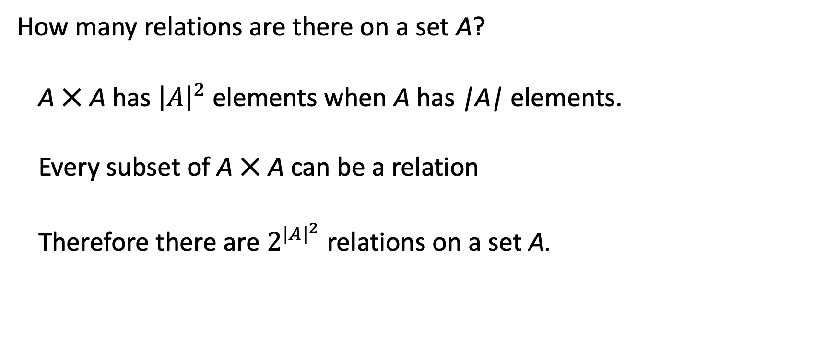
Number of Relations on a Set
How many relations are there on a set A?
A ⨉ A has ${\left|A\right|}^{2}$ elements when A has |A| elements.
Every subset of A ⨉ A can be a relation
Therefore there are $2^{{\left|A\right|}^{2}}$ relations on a set A.

Slide 12
Summary
Properties of Relations
Reflexive Relations
Symmetric and Antisymmetric Relations
Transitive Relations

Slide 13
Equivalence Relations
Section 9.5

Slide 14
Video 24: Equivalence Relations
Equivalence Relations
Equivalence Classes
Equivalence Classes and Partitions

Slide 15
Equivalence Relations
Definition 1: A relation on a set A is called an equivalence relation if it is reflexive, symmetric, and transitive.
Definition 2: Two elements a, and b that are related by an equivalence relation are called equivalent.
The notation a ∼ b is often used to denote that a and b are equivalent elements with respect to a particular equivalence relation.

Slide 16
Example
R_{minus} = { (a, b) ∊ R ⨉ R | a - b ∊ Z }
Is R an equivalence relation?
Reflexive: 0 – 0 = 0, 0 is an integer.
Symmetric: a – b = b – a, if a – b is in integer, then b – a is an integer.
Transitive: (a – b) + (b – c) = a – c, if a – b is an integer and b – c is an integer, then a – c is an integer.

Slide 17
Example
R_{divides} = { (a, b) ∊ N ⨉ N | a divides b } = { (a, b) ∊ N ⨉ N | a | b }
Is R an equivalence relation?
No, it is not symmetric: 2 divides 4, but 4 does not divide 2

Slide 18
Equivalence Classes
Definition 3: Let R be an equivalence relation on a set A. The set of all elements that are related to an element a of A is called the equivalence class of a.
The equivalence class of a with respect to R is denoted by [a]_{R}.
When only one relation is under consideration, we can write [a].
Note that [a]_{R} = {s|(a, s) ∈ R}.
If b ∈ [a]_{R}, then b is called a representative of this equivalence class.
Any element of a class can be used as a representative of the class.

Slide 19

Example
What is the equivalence class of R_{minus} = { (a, b) ∊ R ⨉ R | a - b ∊ Z } of element 0.
$${[0]}_{R_{minus}}=ℤ$$

Slide 20
Equivalence Classes and Partitions
Theorem 1: let R be an equivalence relation on a set A. These statements for elements a and b of A are equivalent:
(i) R(a, b)
(ii) [a] = [b]
(iii) [a] ∩ [b] ≠ ∅

Slide 21
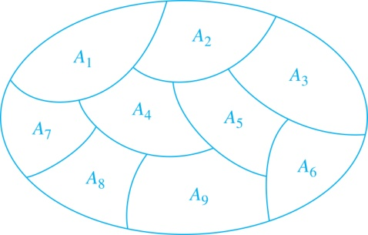
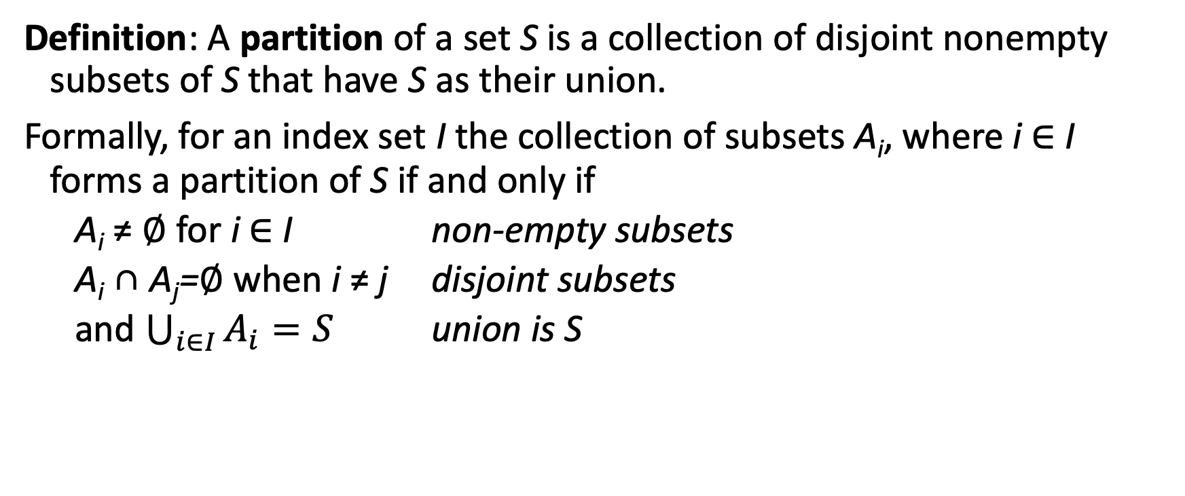
Partition of a Set
Definition: A partition of a set S is a collection of disjoint nonempty subsets of S that have S as their union.
Formally, for an index set I the collection of subsets A_{i}, where i ∈ I forms a partition of S if and only if
A_{i} ≠ ∅ for i ∈ I non-empty subsets
A_{i} ∩ A_{j}=∅ when i ≠ j disjoint subsets
and $\bigcup_{i∈I}{A_{i}=S}$ union is S
A Partition of a Set

Slide 22
An Equivalence Relation Partitions a Set
Theorem 2: Let R be an equivalence relation on a set S. Then the equivalence classes of R form a partition of S. Conversely, given a partition {A_{i} | i ∈ I} of the set S, there is an equivalence relation R that has the sets A_{i}, i ∈ I, as its equivalence classes.

Slide 23
Summary
Equivalence Relations
Equivalence Classes
Partitions
Equivalence Classes and Partitions

Slide 24
Partial Orderings
Section 9.6

Slide 25
Video 25: Partial Ordering
Partial Orderings and Partially-ordered Sets
Lexicographic Orderings
Hasse Diagrams
Lattices
Topological Sorting

Slide 26
Partial Orderings
Definition 1: A relation R on a set S is called a partial ordering, or partial order, if it is reflexive, antisymmetric, and transitive.
A set together with a partial ordering R is called a partially ordered set, or poset, and is denoted by (S, R).

Slide 27
(Z, ≥) is a poset
Show that the “greater than or equal” relation (≥) is a partial ordering on the set of integers.
Reflexivity: a ≥ a for every integer a.
Antisymmetry: If a ≥ b and b ≥ a , then a = b.
Transitivity: If a ≥ b and b ≥ c , then a ≥ c.

Slide 28
(Z⁺, ∣) is a poset
The divisibility relation (∣) is a partial ordering on the set of integers.
Reflexivity: a ∣ a for all integers a.
Antisymmetry: If a and b are positive integers with a | b and b | a, then a = b.
Transitivity: Suppose that a | b and b | c. Then there are positive integers k and l such that b = ak and c = bl. Hence, c = a(kl), so a divides c. Therefore, the relation is transitive.

Slide 29
(P(S), ⊆) is a poset
The inclusion relation (⊆) is a partial ordering on the power set of a set S.
Reflexivity: A ⊆ A whenever A is a subset of S.
Antisymmetry: If A and B are sets with A ⊆ B and B ⊆ A, then A = B.
Transitivity: If A ⊆ B and B ⊆ C, then A ⊆ C.

Slide 30
Lattices
Definition: A partially ordered set in which every pair of elements has both a least upper bound and a greatest lower bound is called a lattice.
Example: (P(S), ⊆) is a lattice.
Proof: The least upper bound of two subsets A and B is A ∪ B, the greatest lower bound is A ∩ B

Slide 31
Partial Order on Cartesian Product
Definition: Given two posets (A₁, ≼₁) and (A₂, ≼₂), the lexicographic ordering on A₁ ⨉ A₂ is defined by specifying that (a₁, a₂) is less than (b₁, b₂), that is,
(a₁, a₂) ≺ (b₁, b₂),
either if a₁ ≺₁ b₁ or if a₁ = b₁ and a₂ ≺₂ b₂.
This definition can be easily extended to a lexicographic ordering on n-ary Cartesian products

Slide 32
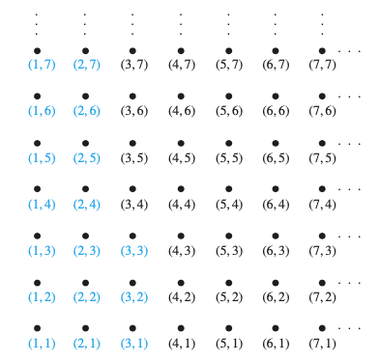
Example
(Z ⨉ Z, ≺)
All ordered pairs less than (3, 4)

Slide 33
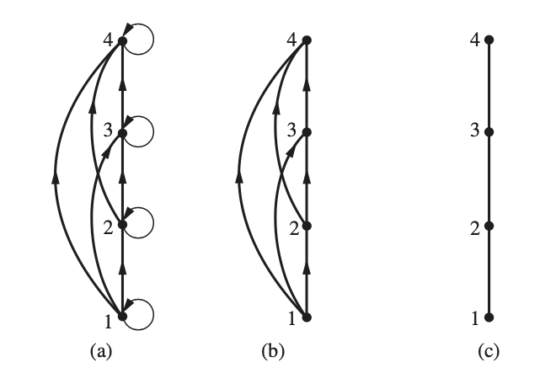
Hasse Diagrams
If a relation is reflexive and transitive, the representation as directed graph can be simplified
If R is a partial order then we can (a) omit self-loops, (b) omit transitive edges and (c) assume that arrows point upwards
(c) Is a Hasse Diagram

Slide 34
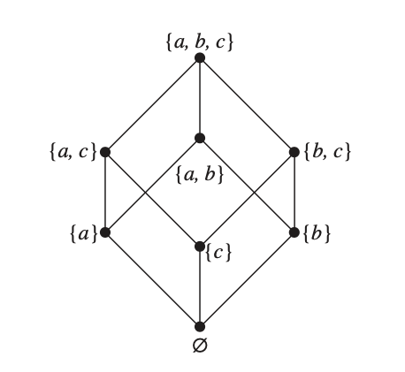
Example
Hasse Diagram of
(P({a, b, c}), ⊆)

Slide 35
Comparability
The symbol ≼ is used to denote the relation in any poset
Definition 2: The elements a and b of a poset (S,≼ ) are comparable if either a ≼ b or b ≼ a. When a and b are elements of S so that neither a ≼ b nor b ≼ a, then a and b are called incomparable.
Definition 3: If (S,≼ ) is a poset and every two elements of S are comparable, S is called a totally ordered or linearly ordered set, and ≼ is called a total order or a linear order.
Definition 4: (S,≼ ) is a well-ordered set if it is a poset such that ≼ is a total ordering and every nonempty subset of S has a least element.

Slide 36
Example
The poset (Z, ≤) is totally ordered
For every two integers a and b, either a ≤ b or b ≤ a (or both)
The poset (Z⁺, ∣) is not totally ordered
For integers 5 and 7, 5 does not divide 7, and 7 does not divide 5
The poset (P(S), ⊆) is not totally ordered if |S| > 1
Since there are at least two elements a and b in S, we have subsets {a} and {b} which are not comparable

Slide 37
Summary
Partial Orderings and Partially-ordered Sets
Lexicographic Orderings
Lattices
Visualization: Hasse Diagrams
Total Orderings
Well-ordered sets

Slide 38
Sequences and Summations
Section 2.4

Slide 39
Video 26: Sequences
Sequences
Examples of Sequences
Recurrence relations

Slide 40
Introduction
Sequences are ordered lists of elements of a set
1, 2, 3, 5, 8
c, o, m, p, u, t, e, r
1, 3, 9, 27, 81, …
Sequences arise throughout mathematics, computer science, and in many other sciences and arts, e.g. biology or music

Slide 41
Sequences
Definition: A sequence is a function from a subset of the integers to a set S.
Usually it is either the set Z⁺ or N.
Let f : Z⁺ → S be the function that defines a sequence.
We write a_{n} to denote the image f(n) of the integer n.
The notation a_{n} is used to denote the image of the integer n.
We call a_{n} a term of the sequence.

Slide 42
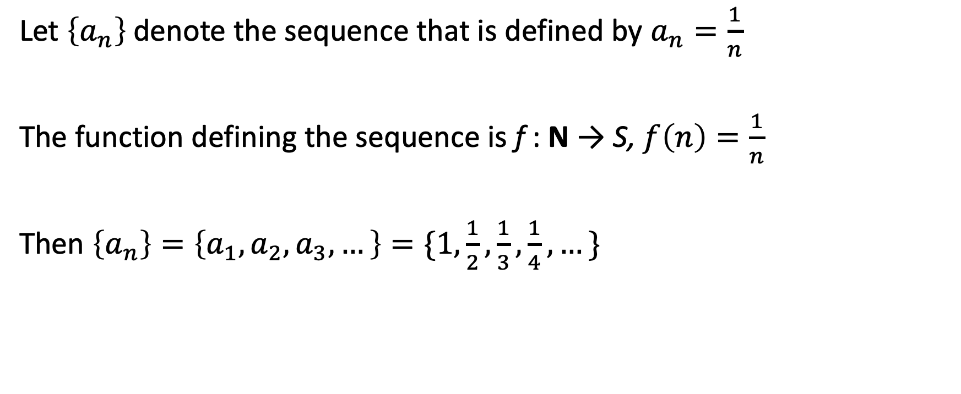
Example
Let $\left\{a_{n}\right\}$denote the sequence that is defined by $a_{n}=\frac{1}{n}$
The function defining the sequence is f : N → S, $f\left(n\right)=\frac{1}{n}$
Then $\left\{a_{n}\right\}=\left\{a_{1},a_{2},a_{3},…\right\}=\{1,\frac{1}{2},\frac{1}{3},\frac{1}{4},…\}$

Slide 43
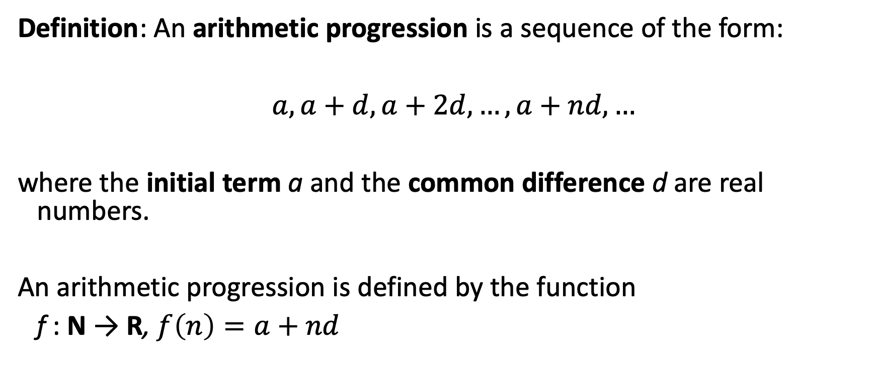
Arithmetic Progression
Definition: An arithmetic progression is a sequence of the form:
$a,a+d,a+2d,…,a+nd,…$
where the initial term a and the common difference d are real numbers.
An arithmetic progression is defined by the function
f : N → R, $f\left(n\right)=a+nd$

Slide 44
Examples
Let a = −1 and d = 4:
Let a = 7 and d = −3:
Let a = 1 and d = 2:

Slide 45
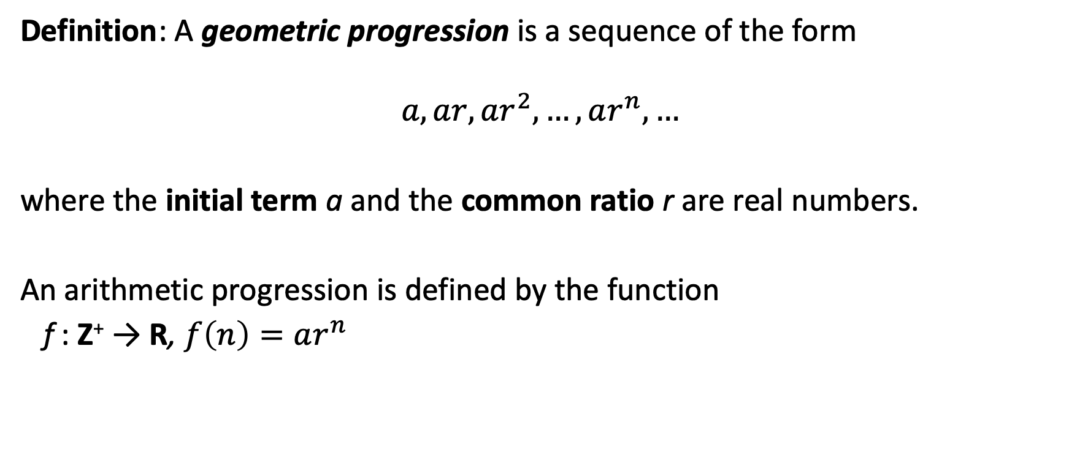
Geometric Progression
Definition: A geometric progression is a sequence of the form
$$a,ar,ar^{2},…,ar^{n},…$$
where the initial term a and the common ratio r are real numbers.
An arithmetic progression is defined by the function
f : Z⁺ → R, $f\left(n\right)=ar^{n}$

Slide 46
Examples
Let a = 1 and r = −1. Then:
Let a = 2 and r = 5. Then:
Let a = 6 and r = 1/3. Then:

Slide 47
Strings
Definition: A string is a finite sequence of characters from a finite set A (an alphabet).
A string is defined by a function
f : {1, … , n} → A
Sequences of characters or bits are important in computer science.
The empty string is represented by λ.
The string abcde has length 5.

Slide 48
Lexicographic Ordering on Strings
Consider strings of lowercase English letters.
A lexicographic ordering can be defined using the ordering of the letters in the alphabet.
discreet ≺ discrete, because these strings differ in the seventh position and e ≺ t.
discreet ≺ discreetness, because the first eight letters agree, but the second string is longer.
Strings with lexicographic ordering are well-ordered sets.
This is the same ordering as that used in dictionaries.

Slide 49
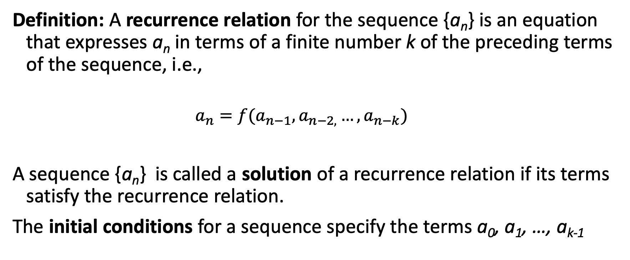
Recurrence Relations
Definition: A recurrence relation for the sequence {a_{n}} is an equation that expresses a_{n} in terms of a finite number k of the preceding terms of the sequence, i.e.,
$$a_{n}=f(a_{n−1},a_{n−2,}…,a_{n−k})$$
A sequence {a_{n}} is called a solution of a recurrence relation if its terms satisfy the recurrence relation.
The initial conditions for a sequence specify the terms a₀, a₁, …, a_{k-1}

Slide 50
Example
Let {a_{n}} be a sequence that satisfies the recurrence relation
a_{n} = a_{n-1} + 3 for n = 1, 2, 3, 4,….
and suppose that a₀ = 2.
Then
a₁ = 2 + 3 = 5
a₂ = 5 + 3 = 8
a₃ = 8 + 3 = 11

Slide 51
Example
Let {a_{n}} be a sequence that satisfies the recurrence relation
a_{n} = a_{n-1} – a_{n-2} for n = 2,3,4,….
and suppose that a₀ = 3 and a₁ = 5.
Then
a₂ = 5 – 3 = 2
a₃ = 2 – 5 = -3
a₄ = -3 – 2 = -5
a₅ = -5 + 3 = -2

Slide 52
Summary
Sequences
Examples of Sequences
Arithmetic progression
Geometric progression
Strings
Recurrence relations

Slide 53
Video 27: Number Sequences
Guessing sequences of numbers
Modeling using number sequences
Solving recurrence relations

Slide 54
Guessing Sequences of Numbers
Given a few terms of a sequence, try to identify the sequence. Conjecture a closed formula, recurrence relation, or some other pattern.
Some questions to ask?
Are there repeated terms of the same value?
Can you obtain a term from the previous term by adding an amount or multiplying by an amount?
Can you obtain a term by combining the previous terms in some way?
Are there cycles among the terms?
Do the terms match those of a well known sequence?

Slide 55
Example
Find a formulae for the sequence with the following first five terms:
1, 3, 5, 7, 9
We observe that each term is obtained by adding 2 to the previous term.
A possible formula is a_{n} = a + 2n
Since a₀ = 1 we conclude a = 1
This is an arithmetic progression with a = 1 and d = 2.

Slide 56
Example
Find a formulae for the sequence with the following first five terms:
1, ½, ¼, 1/8, 1/16
We observe that the denominators are powers of 2.
We guess that the sequence with a_{n} = 1/2^{n} is a possible match.
This is a geometric progression with a = 1 and r = ½.

Slide 57
Example
Find a formulae for the sequence with the following first five terms:
1, -1, 1, -1,1
We observe that the terms alternate between 1 and -1.
A possible sequence is a_{n} = (−1)^{n} .
This is a geometric progression with a = 1 and r = −1.

Slide 58
Rabbits
A young pair of rabbits (one of each gender) is placed on an island.
A pair of rabbits does not breed until they are 2 months old.
After they are 2 months old, each pair of rabbits produces another pair each month.
Find a recurrence relation for the number of pairs of rabbits on the island after n months, assuming that rabbits never die.
This is the original problem considered by Leonardo Pisano (Fibonacci) in the thirteenth century.

Slide 59
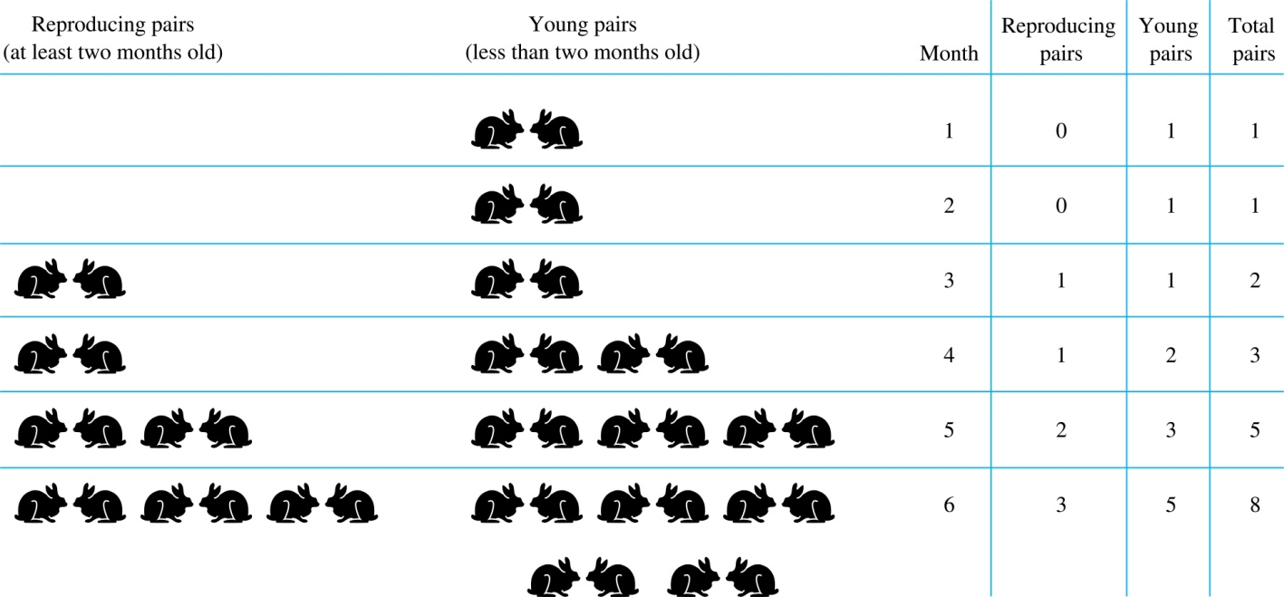
Modeling the Population Growth of Rabbits

Slide 60
Fibonacci Sequence
Definition: The Fibonacci sequence f₀ ,f₁ ,f₂,… is defined as:
Initial Conditions: f₀ = 0, f₁ = 1
Recurrence Relation: f_{n} = f_{n-1} + f_{n-2}
f₂ = f₁ + f₀ = 1 + 0 = 1
f₃ = f₂ + f₁ = 1 + 1 = 2
f₄ = f₃ + f₂ = 2 + 1 = 3
f₅ = f₄ + f₃ = 3 + 2 = 5
f₆ = f₅ + f₄ = 5 + 3 = 8

Slide 61
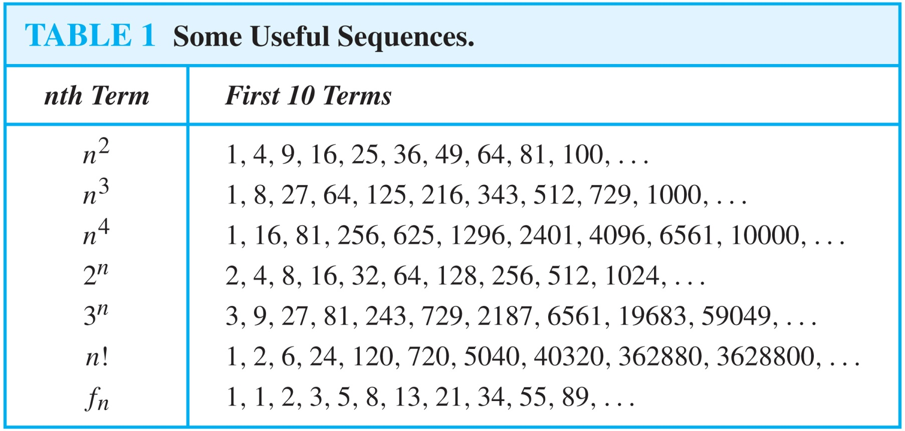
Integer Sequences

Slide 62
Solving Recurrence Relations
Finding a formula for the n^{th} term of the sequence generated by a recurrence relation is called solving the recurrence relation.
Such a formula is called a closed formula.
Various methods for solving recurrence relations will be covered in Advanced Counting, where recurrence relations will be studied in greater depth.

Slide 63
Solving Recurrence Relations
Let {a_{n}} be a sequence that satisfies the recurrence relation a_{n} = a_{n-1} + 3 for n = 2,3,4,…. and suppose that a₁ = 2.
We may solve the recurrence relation by guessing the formula
Step 1: substitute repeatedly the recurrence
a_{n} = a_{n-1} + 3
= (a_{n-2} + 3) + 3 = a_{n-2} + 3 ∙ 2
= (a_{n-3} + 3 )+ 3 ∙ 2 = a_{n-3} + 3 ∙ 3
…
= a₂ + 3(n – 2) = (a₁ + 3) + 3(n – 2) = 2 + 3(n – 1)
Step 2: guess the formula: a_{n} = 2 + 3(n – 1)
Step 3: verify that your guess is right:
a₁ = 2 + 3*(1-1) = 2, initial condition is ok
a_{n} = 2 + 3*(n-1) = a_{n-1} + 3 = 2 + 3*(n—2) + 3, recurrence is ok

Slide 64
Summary
Guessing sequences of numbers
Modeling using number sequences
Fibonacci sequence
Special integer sequences
Solving recurrence relations

Slide 65
Video 28: Summations
Sum and Product Notation
Closed formula for geometric series
Important summation formulae

Slide 66
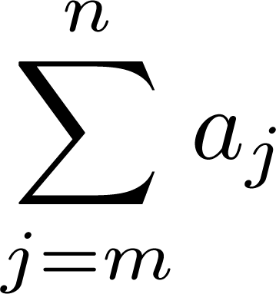
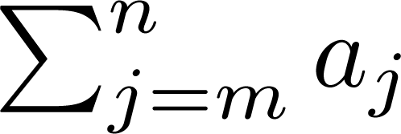
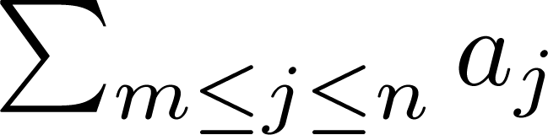
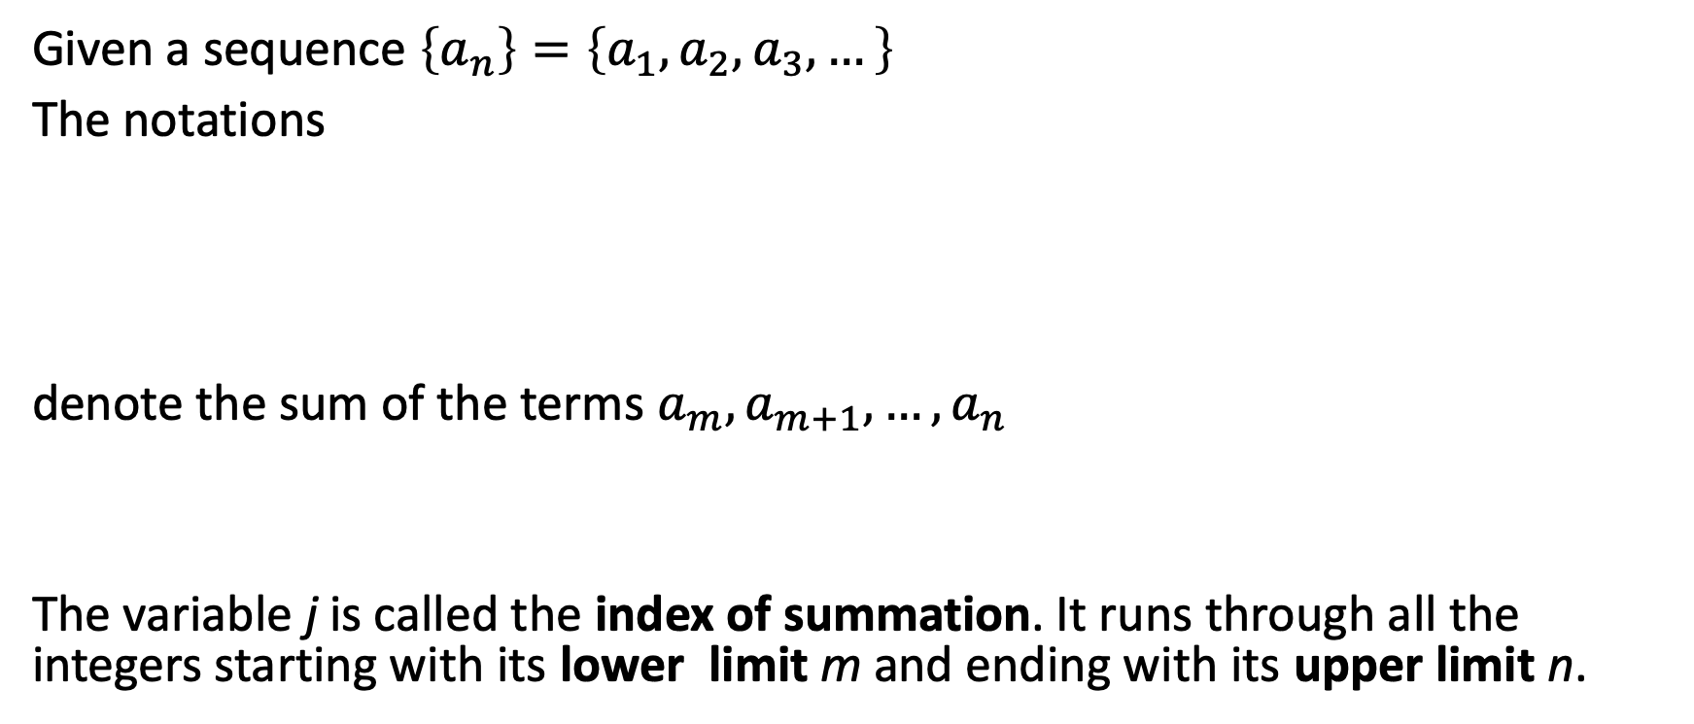
Summation Notation
Given a sequence $\left\{a_{n}\right\}=\left\{a_{1},a_{2},a_{3},…\right\}$
The notations
denote the sum of the terms $a_{m},a_{m+1},…,a_{n}$
The variable j is called the index of summation. It runs through all the integers starting with its lower limit m and ending with its upper limit n.

Slide 67
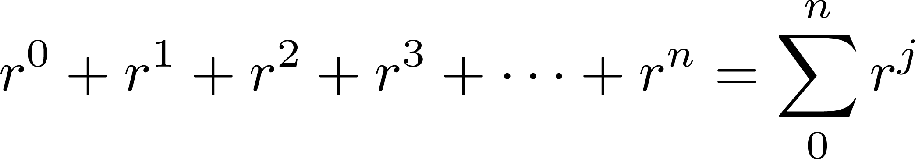
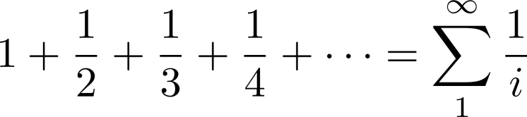
Example
The upper limit can be infinite!

Slide 68
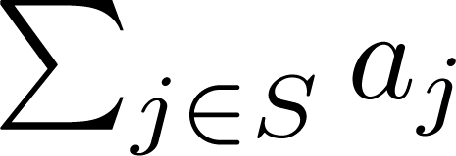
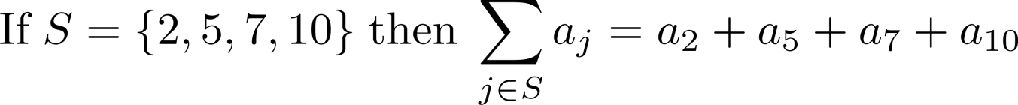
Summation over Sets
More generally for a set S we can denote
Example:

Slide 69
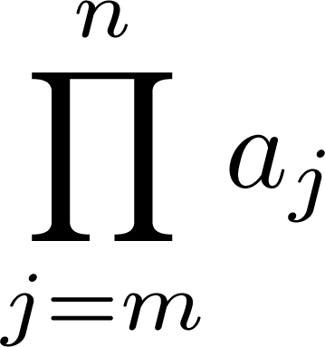
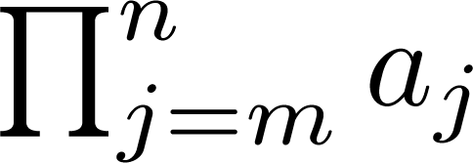
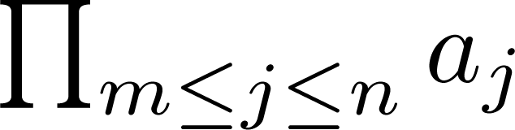

Product Notation
Given a sequence $\left\{a_{n}\right\}=\left\{a_{1},a_{2},a_{3},…\right\}$
The notations
denote the product of the terms $a_{m},a_{m+1},…,a_{n}$

Slide 70
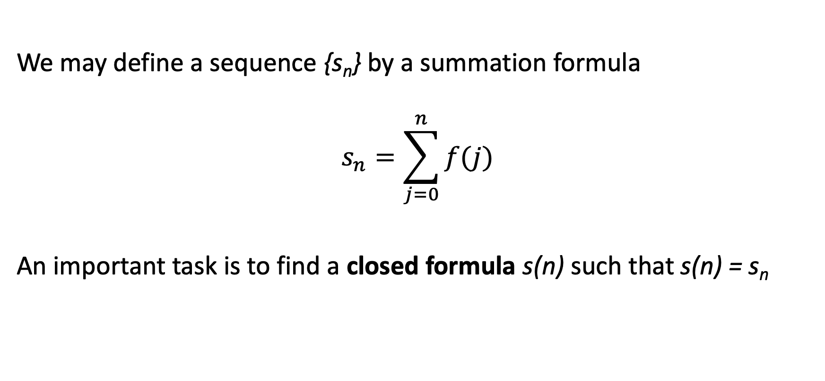
Sums as Sequences
We may define a sequence {s_{n}} by a summation formula
$$s_{n}=\sum_{j=0}^{n}{f(j)}$$
An important task is to find a closed formula s(n) such that s(n) = s_{n}

Slide 71
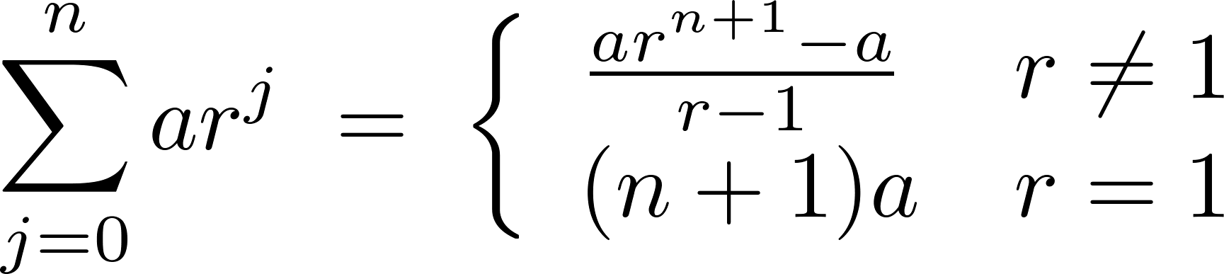
Geometric Series
Theorem: If a and r are real numbers and r ≠ 0, then

Slide 72
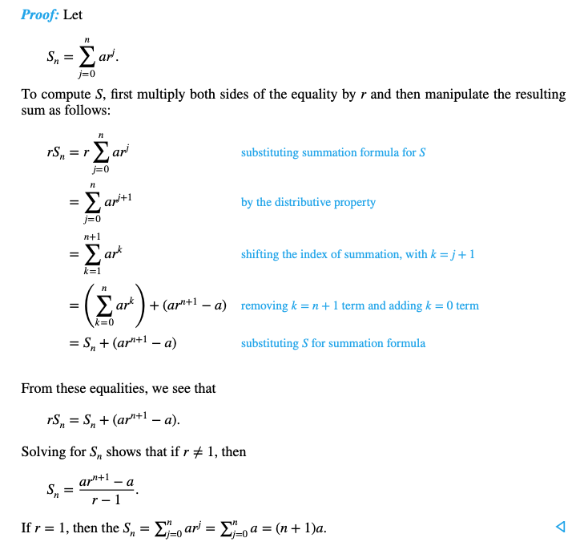
Proof

Slide 73
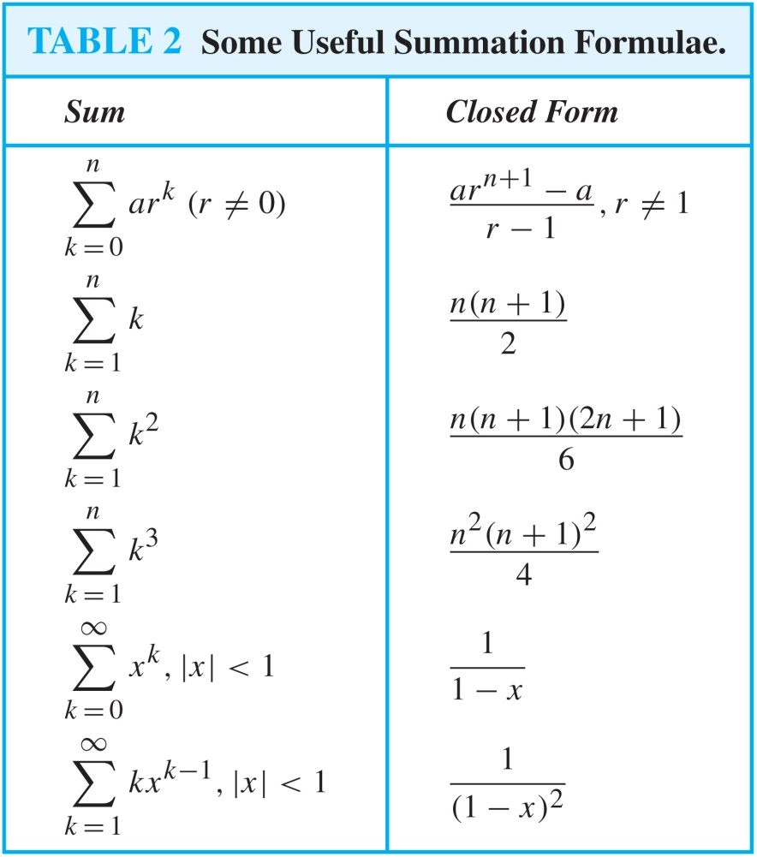
Important Summation Formulae
Geometric Series: We just proved this.
We will be able to prove these using induction.
These proofs require analysis

Slide 74
Summary
Sum and Product Notation
Closed formula for geometric series
Important summation formulae

Slide 75
Cardinality of Sets
Section 2.5

Slide 76
Video 29: Cardinality of Sets
Cardinality
Countable Sets

Slide 77
Cardinality
Definition: The cardinality of a set A is equal to the cardinality of a set B, denoted by |A| = |B| iff there is a bijection from A to B.
If there is an injection from A to B, the cardinality of A is less than or the same as the cardinality of B and we write |A| ≤ |B|.
When |A| ≤ |B| and A and B have different cardinality, we say that the cardinality of A is less than the cardinality of B and write |A| < |B|.

Slide 78
Countable Sets
Definition: A set that is either finite or has the same cardinality as the set of positive integers Z⁺ is called countable. A set that is not countable is uncountable.
When an infinite set is countable (countably infinite) its cardinality is ℵ₀.
We write |S| = ℵ₀ and say that S has cardinality “aleph null.”
Note: ℵ is aleph, the 1st letter of the Hebrew alphabet

Slide 79
Showing that a Set is Countable
Theorem: An infinite set S is countable iff it is possible to list the elements of the set in a sequence indexed by the positive integers.
Proof:
If the set is countable, there exists a bijection from Z⁺ to S.
Therefore we can form the sequence a₁,a₂,…, a_{n} ,… where
a₁ = f(1), a₂ = f(2),…, a_{n} = f(n),…
If we can list the set in a sequence {a_{n}} indexed by the positive integers, we can define the function
f(n) = a_{n}
which is a bijection.

Slide 80
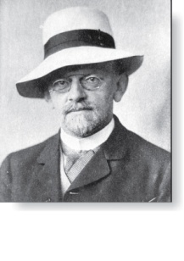
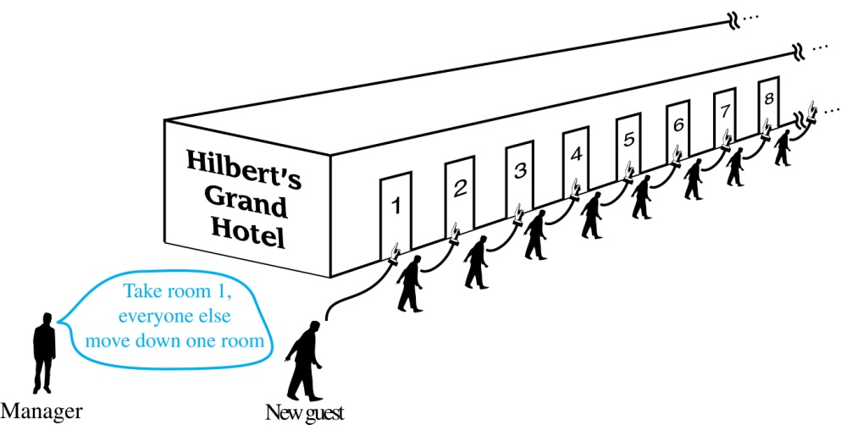
Hilbert’s Grand Hotel
David Hilbert
The Grand Hotel has countably infinite number of rooms, each occupied by a guest. We can always accommodate a new guest at this hotel. How is this possible?
Explanation:
Because the rooms of Grand Hotel are countable, we can list them as Room 1, Room 2, Room 3, and so on.
When a new guest arrives, we move the guest in Room 1 to Room 2, the guest in Room 2 to Room 3, and in general the guest in Room n to Room n + 1, for all positive integers n.
This frees up Room 1, which we assign to the new guest, and all the current guests still have rooms.

Slide 81
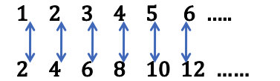
Example
Show that the set of positive even integers E is countable set.
Let f : Z⁺ → E, f(x) = 2x.
Then f is a bijection from Z⁺ to E since f is both injective and surjective.
Proof:
Suppose that f(n) = f(m). Then 2n = 2m, and so n = m. Therefore it is injective.
Suppose that t is an even positive integer. Then t = 2k for some positive integer k and f(k) = t. Therefore it is surjective.

Slide 82
Example
Show that the set of integers Z is countable.
We can define a bijection from N to Z
When n is even: f(n) = n/2
When n is odd: f(n) = −(n−1)/2
Alternatively we can list the numbers in a sequence
0, 1, − 1, 2, − 2, 3, − 3 ,…

Slide 83
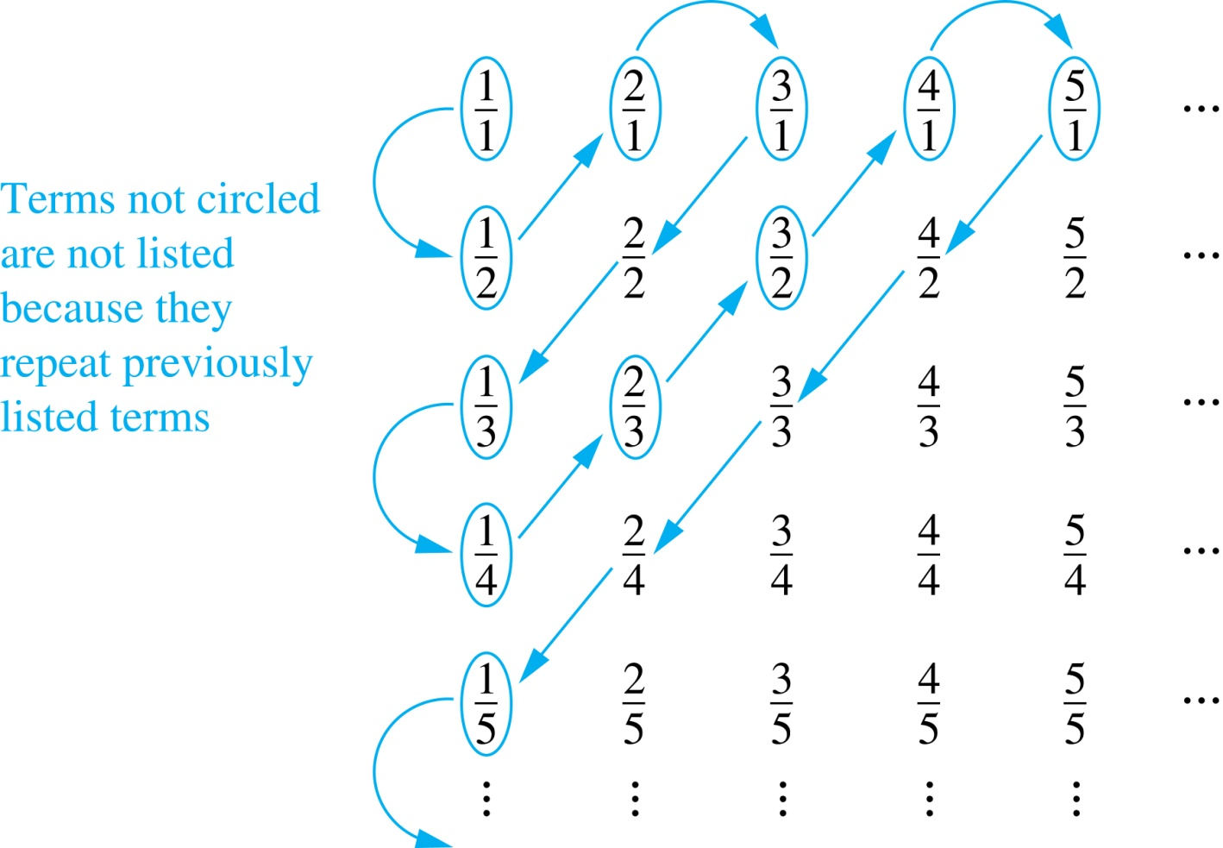
The Positive Rational Numbers are Countable
The positive rational numbers are countable since they can be arranged in a sequence r₁ , r₂ , r₃ ,…
First row q = 1.
Second row q = 2.
etc.
Constructing the List
First list p/q with p + q = 2.
Next list p/q with p + q = 3
And so on.
1, ½, 2, 3, 1/3,1/4, 2/3, ….

Slide 84
The Set of Finite Strings is Countable
The set of finite strings S over a finite alphabet A is countably infinite.
Show that the strings can be listed in a sequence.
First list
All the strings of length 0 in alphabetical order.
Then all the strings of length 1 in lexicographic order.
Then all the strings of length 2 in lexicographic order.
Etc.

Slide 85
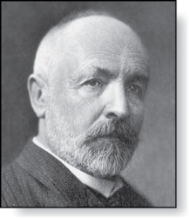
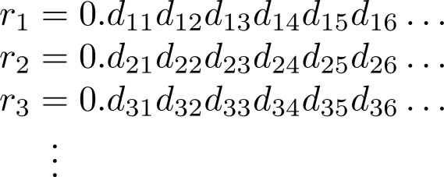
The Set of Real Numbers R is Uncountable
Georg Cantor
Cantor diagnalization argument, a proof by contradiction.
Proof:
Suppose R is countable. Then the real numbers between 0 and 1 are also countable, as any subset of a countable set is countable.
Then the real numbers between 0 and 1 can be listed as a sequence r₁ , r₂ , r₃ ,…
Let the decimal representation of this listing be

Slide 86
Diagonalization
Form a new real number with the decimal expansion
where
r is not equal to any of the r₁ , r₂ , r₃ ,... It differs from r_{i} in its i^{th} position after the decimal point.

Slide 87
Contradiction
Therefore there is a real number between 0 and 1 that is not on the list since every real number has a unique decimal expansion.
Hence, all the real numbers between 0 and 1 cannot be listed, so the set of real numbers between 0 and 1 is uncountable.
Since a set with an uncountable subset is uncountable, the set of real numbers is uncountable.

Slide 88
Summary
Cardinality
Countable Sets
Proving countability
Example of countable sets
Even numbers
Integers
Rational Numbers
Uncountable sets
Real numbers

